Slide 3
INHERITANCE

Slide 4
Inheritance
Inheritance is the process of creating new classes, called derived classes, from existing or base classes.
The derived class inherits all the capabilities of the base class but can add embellishments and refinements of its own
The base class is unchanged by this process
Inheritance permits code reusability.

Slide 5

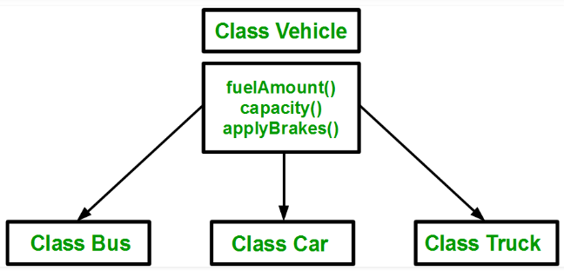
duplication of same code 3 times. This increases the chances of error and data redundancy. To avoid this type of situation, inheritance is used

Slide 6
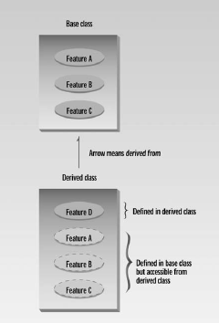
Inheritance
Base / Super / Parent Class and
Derived / Sub / Child Class
Syntax :
class Derived: public Base
{
. . .
. . .
};
Single Colon for inheritance

Slide 7
class A
{
public:
int x;
protected:
int y;
private:
int z;
};
class B : public A
{
// x is public
// y is protected
// z is not accessible from B
};
class C : protected A
{
// x is protected
// y is protected
// z is not accessible from C
};
class D : private A // 'private' is default for classes
{
// x is private
// y is private
// z is not accessible from D
};

Slide 8
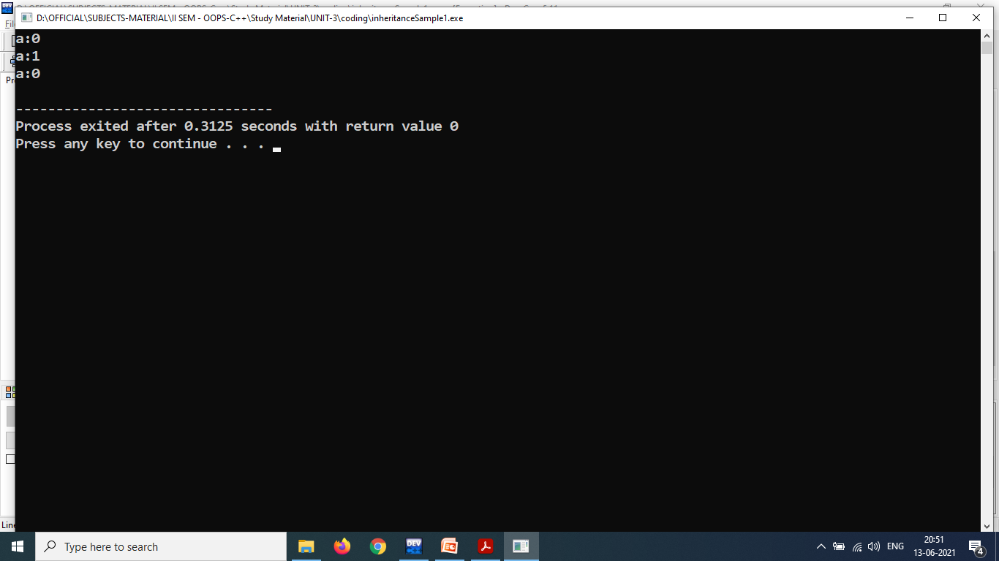
#include<iostream>
using namespace std;
class Base{
protected:
int a;
public:
Base()
{ a=0; }
void increment_a()
{ ++a; }
void show_a()
{ cout<<"a:"<<a<<endl; }
};
class Derived : public Base
{
public:
void decrement_a()
{ --a; }
};
int main()
{
Derived obj1;
obj1.show_a();
obj1.increment_a();
obj1.show_a();
obj1.decrement_a();
obj1.show_a();
}
There is no constructor in the “Derived”.
if you don’t specify a constructor, the derived class will use an appropriate constructor from the base class

Slide 9
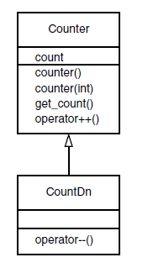
Generalization in UML Class Diagrams
Accessing Base Class Members
An important topic in inheritance is knowing when a member function in the base class can be used by objects of the derived class. This is called accessibility

Slide 10
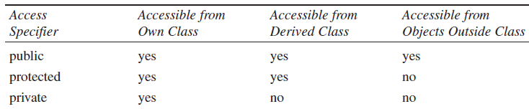
Modes of Inheritance
Public mode: If we derive a sub class from a public base class. Then the public member of the base class will become public in the derived class and protected members of the base class will become protected in derived class.
Protected mode: If we derive a sub class from a Protected base class. Then both public member and protected members of the base class will become protected in derived class.
Private mode: If we derive a sub class from a Private base class. Then both public member and protected members of the base class will become Private in derived class.

Slide 11
Single Inheritance
//Example
class Shape //base class
{
float x,y;
public:
void set()
{
cout<<"Enter x coordinate and y coordinate\n";
cin>>x>>y;
}
float get_x()
{ return x; }
float get_y()
{ return y; }
};
OUTPUT:
Enter x coordinate and y coordinate
5 6
area=15
class Triangle: public Shape //derived
{
float area;
public:
float tri_area()
{
area=0.5*get_x()*get_y();
return area;
}
};
int main()
{
Triangle obj;
obj.set();
cout<<"\narea="<<obj. tri_area();
return 0;
}
x | y | area
5 | 6 | 15
700 704 708 712 obj

Slide 12
Function overriding in single inheritance
Giving new implementation of base class method into derived class is called function overriding.
Signature of base class method and derived class must be same.
Signature involves:
Number of arguments
Type of arguments
Sequence of arguments
class BaseClass
{ public:
void disp()
{ cout<<“Base Class";}
};
class DerivedClass: public BaseClass
{ public:
void disp()
{ cout<<" Derived Class"; }
};
int main()
{ DerivedClass obj;
obj.disp();
}
Output:
Derived Class

Slide 13
Cont…
class BaseClass
{ public:
void disp()
{ cout<<"Base Class\n"; }
};
class DerivedClass: public BaseClass
{ public:
void disp()
{ cout<<"Derived Class\n“; }
};
int main() {
DerivedClass obj = DerivedClass();
obj.BaseClass::disp();
obj.disp();
}
Output:
Base Class
Derived Class
class BaseClass
{ public:
void disp()
{ cout<<"Base Class\n"; }
};
class DerivedClass: public BaseClass{
public:
void disp()
{ BaseClass::disp();
cout<<"Derived Class\n";
}
};
int main()
{ DerivedClass obj = DerivedClass();
obj.disp();
}
Output:
Base Class
Derived Class

Slide 14
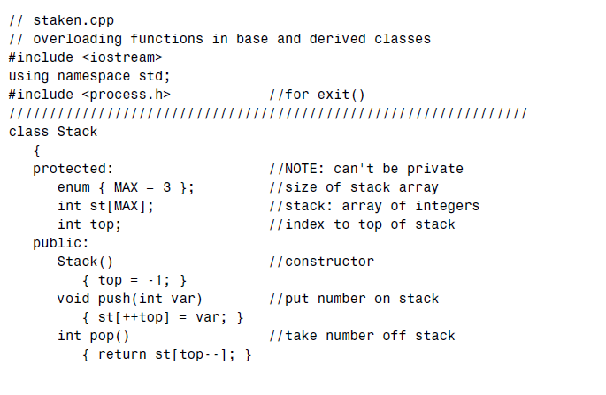
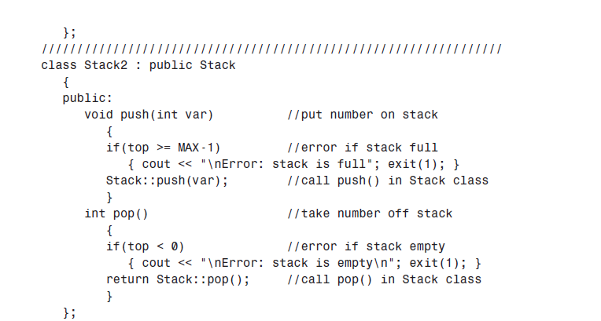
Overriding Member Functions have the same name as—those in the base class.

Slide 15
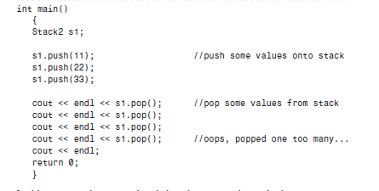

Slide 16
Class Hierarchies
Our example models a database of employees of a widget company
Managers manage, scientists perform research to develop better widgets, and laborers operate the dangerous widget-stamping presses
The database stores a name and an employee identification number for all employees, no matter what their category. However, for managers, it also stores their titles and golf club dues.
For scientists, it stores the number of scholarly articles they have published. Laborers need no
additional data beyond their names and numbers.

Slide 17
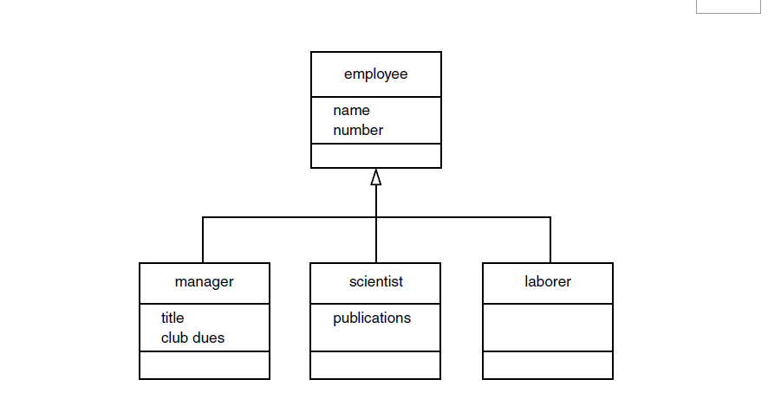

Slide 18
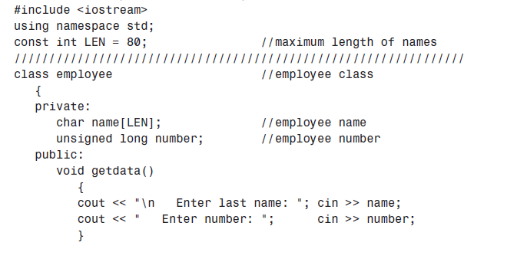
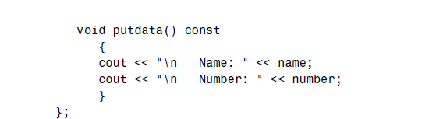

Slide 19
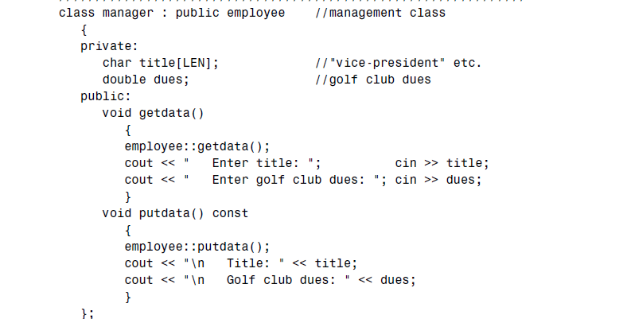

Slide 20
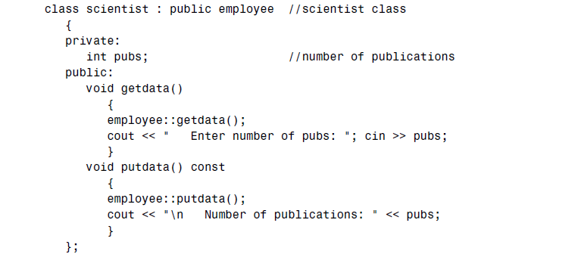

class laborer : public employee //laborer class
{
};

Slide 21
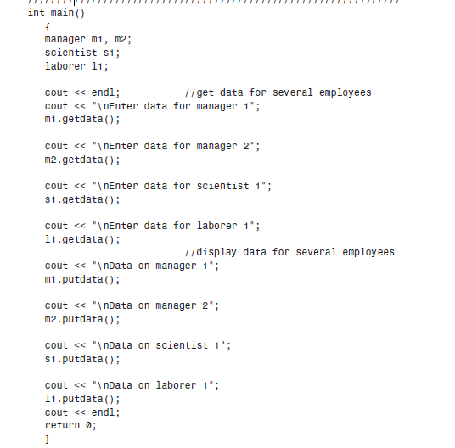

Slide 22
Cont…
Person
Employee
student
Person Employee student
name company name course
no basicpay

Slide 23
Cont… // Hirarchical inheritance
class Person {
int no;
char name[10];
public:
void getPersonDetails()
{
cout << "\nEnter the Person number:";
cin>>no;
cout << "Enter the Person name:";
cin>>name;
}
void person_display()
{
cout <<"\nPerson number:"<<no;
cout <<"\nPerson name:"<<name;
}
};
class Employee : private Person
{
float bp;
public:
void getEmployeeDetails()
{
getPersonDetails();
cout << "Enter the Basic pay:";
cin>>bp;
}
void employee_display()
{
person_display();
cout <<"\nEmployee Basic pay:"<<bp;
}
};
class Student : private Person
{ char course[10];
public:
void getStudentDetails() {
getPersonDetails();
cout << "Enter the Student course Name:";
cin>>course;
}
void student_display()
{person_display();
cout <<"\nStudent Course name:"<<course<<endl;
}
};
int main()
{ char ch;
Student s;
Employee e;
cout << "\nStudent Details \n";
s.getStudentDetails();
s.student_display();
cout << "\nEmployee Details \n";
e.getEmployeeDetails();
e.employee_display();
return 0;
}

Slide 24
Cont…
Output:
Student Details
Enter the Person number:1
Enter the Person name:aaa
Enter the Student course Name:M.Tech
Person number:1
Person name:aaa
Student Course name: M.Tech
Employee Details
Enter the Person number:2
Enter the Person name:bbb
Enter the Basic pay:29000
Person number:2
Person name:bbb
Employee Basic pay:29000
no | name | course
1 | aaa | M.Tech
302 312 322
s
no | name | bp
2 | bbb | 29000
602 612 616
e

Slide 25
“Abstract” Base Class
no actual instances (objects) of this class are created
Employee is abstract class
It always act as base class.

Slide 26
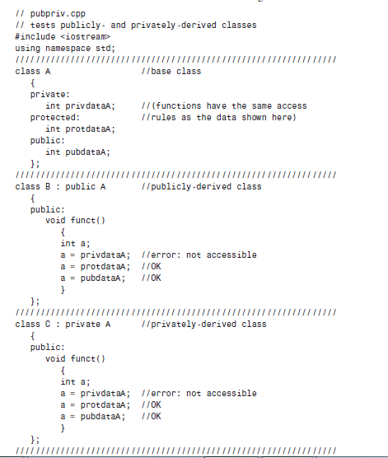

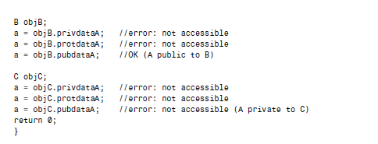

Slide 27
Cont…
Multilevel Inheritance
-a class inherits its properties from another derived class
BASE CLASS
BASE CLASS
DERIVED CLASS-1
DERIVED CLASS-1
DERIVED CLASS-2
DERIVED CLASS-2
DERIVED CLASS-N

Slide 28
Cont…
Person
Employee
programmer
Person Employee programmer
name company name Number of programming language known
age salary

Slide 29
Cont… // Multilevel inheritance
class person
{
char name[10];
int age;
public:
void get_person()
{
cout<<"Name: ";
cin>>name;
cout<<"Age: ";
cin>>age;
}
void put_person()
{
cout<<"Name: "<<name<<endl;
cout<<"Age: "<<age<<endl;
}
};
class employee: public person
{
char company[10];
float salary;
public:
void get_employee()
{
get_person();
cout<<"Name of Company: ";
cin>>company;
cout<<"Salary: Rs.";
cin>>salary;
}
void put_employee()
{
put_person();
cout<<"Name of Company:”
cout<<company<<endl;
cout<<"Salary: Rs."<<salary<<endl;
}
};

Slide 30
class programmer: public employee
{int number;
public:
void get_programmer()
{ get_employee();
cout<<"Number of programming language known: ";
cin>>number;
}
void put_programmer()
{ put_employee();
cout<<"Number of programming language known: "<<number;
}
};
int main()
{ programmer p;
cout<<"Enter data"<<endl;
p.get_programmer();
cout<<endl<<"Displaying data"<<endl;
p.put_programmer();
}
Output:
Enter data
Name: aaa
Age: 24
Name of Company: TCS
Salary: Rs.900000
Number of programming language known: 5
Displaying data
Name: aaa
Age: 24
Name of Company: TCS
Salary: Rs.900000
Number of programming language known: 5
name | age | company | salary | number
aaa | 24 | TCS | 25000 | 5
810 812 822 826 828
p

Slide 31
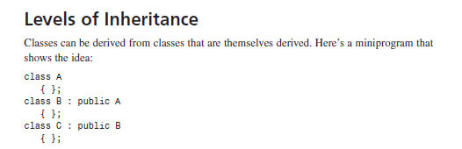

Slide 32
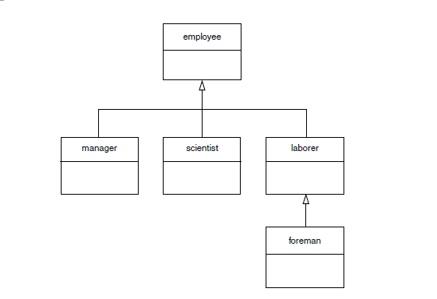

Slide 33
include <iostream>
using namespace std;
const int LEN = 80; //maximum length of names
////////////////////////////////////////////////////////////////
class employee
{
private:
char name[LEN]; //employee name
unsigned long number; //employee number
public:
void getdata()
{
cout << “\n Enter last name: “; cin >> name;
cout << “ Enter number: “; cin >> number;
}
void putdata() const
{
cout << “\n Name: “ << name;
cout << “\n Number: “ << number;
}
};

Slide 34
class manager : public employee //manager class
{
private:
char title[LEN]; //”vice-president” etc.
double dues; //golf club dues
public:
void getdata()
{
employee::getdata();
cout << “ Enter title: “; cin >> title;
cout << “ Enter golf club dues: “; cin >> dues;
}
void putdata() const
{
employee::putdata();
cout << “\n Title: “ << title;
cout << “\n Golf club dues: “ << dues;
}
};

Slide 35
class scientist : public employee //scientist class
{
private:
int pubs; //number of publications
public:
void getdata()
{
employee::getdata();
cout << “ Enter number of pubs: “; cin >> pubs;
}
void putdata() const
{
employee::putdata();
cout << “\n Number of publications: “ << pubs;
}
};

Slide 36
class laborer : public employee //laborer class
{
};
////////////////////////////////////////////////////////////////
class foreman : public laborer //foreman class
{
private:
float quotas; //percent of quotas met successfully
public:
void getdata()
{
laborer::getdata();
cout << “ Enter quotas: “; cin >> quotas;
}
void putdata() const
{
laborer::putdata();
cout << “\n Quotas: “ << quotas;
}
};

Slide 37
int main()
{
laborer l1;
foreman f1;
cout << endl;
cout << “\nEnter data for laborer 1”;
l1.getdata();
cout << “\nEnter data for foreman 1”;
f1.getdata();
cout << endl;
cout << “\nData on laborer 1”;
l1.putdata();
cout << “\nData on foreman 1”;
f1.putdata();
cout << endl;
return 0;
}

Slide 38
Multiple Inheritance

Slide 39
Cont…
Multiple Inheritance:
-one derived class is inherited from more than one base class
BASE CLASS- 1
BASE CLASS-2
BASE CLASS-N
DERIVED CLASS

Slide 40
Cont… multiple inheritance
class Sum: public Number1,public Number2
{
public:
int add()
{
return no1+no2;
}
};
int main()
{
Sum obj;
cout<<"Enter number1 and number2 for addition\n";
obj.get_no1();
obj.get_no2();
cout<<"sum= "<<obj.add();
return 0;
}
class Number1
{
protected:
int no1;
public:
void get_no1()
{
cin>>no1;
}
};
class Number2
{
protected:
int no2;
public:
void get_no2()
{
cin>>no2;
}
};
Output:
Enter number1 and number2 for addition
4 5
sum= 9
no1 | no2
4 | 5
302 304 obj

Slide 41
Function overriding in multiple inheritance
class Base1
{ public:
void fun()
{ cout<<"Base1\n";}
};
class Base2
{public:
void fun()
{ cout<<"Base2\n";}
};
class Derived : public Base1, public Base2
{ public:
void fun( )
{cout<<"Derived\n"; }
};
int main()
{ Derived obj;
obj.fun();
}
Output:
Derived

Slide 42
Function overriding in multiple inheritance
Ambiguity in Multiple Inheritance
Suppose, two base classes have a same function which is not overridden in derived class. If that function is called by using the derived class object ,the compiler shows error because the compiler doesn't know which function to call
class Base1
{ public:
void fun()
{ cout<<"Base1\n";}
};
class Base2
{ void fun( )
{cout<<"Base2\n"; }
};
class Derived : public Base1, public Base2
{ };
int main()
{
Derived obj;
obj.fun(); // Error!
}

Slide 43
Ambiguity in Multiple Inheritance can be solved using scope resolution
class Base1
{ public:
void fun()
{ cout<<"Base1\n";}
};
class Base2
{ public:
void fun()
{ cout<<"Base2\n";} };
class Derived : public Base1, public Base2
{ };
int main()
{ Derived obj;
//obj.fun();
obj. Base1::fun();
obj.Base2::fun();
}
class Base1
{ public:
void fun()
{ cout<<"Base1\n";}
};
class Base2
{ public:
void fun()
{ cout<<"Base2\n";} };
class Derived : public Base1, public Base2
{ public:
void fun( )
{ Base1::fun();
Base2::fun();
cout<<"Derived\n";
}
};
int main()
{ Derived obj;
obj.fun();
}
Output
Base1
Base2
Output
Base1
Base2
Derived

Slide 44
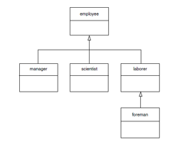

Slide 45
Class student{ char school[80]; char deg[20];}
Class employee{ char name[20],int number;}
Class manager: public employee, public student{}
Class scientist : pubic employee, public student{}
Class laborer:public employee

Slide 46
Inheritance PART IV

Slide 47
Cont…
Hybrid Inheritance:
student
test
sports
result
Multilevel + Multiple Inheritance

Slide 48
Cont… //sample program to explain Hybrid inheritance
class result : public test, public sports
{ int total;
public:
void display ()
{ total = part1 + part2 + score;
putRollno();
putMarks();
putSportsMarks();
cout << "Total Score : " << total ;
}
};
int main ()
{ result s1;
s1.getRollno();
s1.getMarks();
s1.getSportsMarks();
s1.display();
return 0;
}
class student
{ protected:
int r_no;
public:
void getRollno()
{ cin >> r_no; }
void putRollno()
{ cout << r_no ; }
};
class test : public student
{ protected:
int part1, part2;
public:
void getMarks()
{ cin >> part1>> part2; }
void putMarks()
{ cout << part1<< part2 << "\n"; }
};
class sports
{ protected:
int score;
public:
void getSportsMarks()
{ cin >> score; }
void putSportsMarks()
{ cout << score ;}
};

Slide 49
Execution order of constructor and destructor
Both base class and derived class can have their own constructor and destructor functions
The constructor functions are executed in the order of derivation
The destructor functions are executed in the reverse order
Base class
Derived class1
Derived class2
Derived classN
Base class ,Derived class1 ,Derived class2,……………………………Derived classN
Derived class N ,Derived class N-1 ,Derived N-2,……………………………….Derived class1,Base class

Slide 50
Cont…
output
base constructor
derived1 constructor
derived2 constructor
derived2 destructor
derived1 destructor
base destructor
Whenever the derived class’s default constructor is called, the base class’s default constructor is called automatically
Base class data members are all initialized first, before initializing the derived class member
Derived class data members are all destroyed first, before destroying the base class members
class Base
{ public:
Base()
{ cout<<"base constructor\n";}
~Base()
{ cout<<"base destructor\n";}
};
class derived1:public Base
{ public:
derived1()
{ cout<<"derived1 constructor\n";}
~derived1()
{ cout<<"derived1 destructor\n";}
};
class derived2 : public derived1
{public:
derived2()
{ cout<<"derived2 constructor\n";}
~derived2()
{ cout<<"derived2 destructor\n";}
};
int main()
{ derived2 obj;
}

Slide 51
Cont…
In case of multiple inheritance the order of execution of constructors depend upon the order of inheritance
The constructor functions are executed in the order of inheritance
Base class1
Base class2
Base class N
Derived class
Base class 1 ,Base class2 ……….Base classN ,Derived class
The destructor functions are executed in the reverse order
Derived class ,Base class N ,Base classN-1………….. Base class1

Slide 52
Cont…
A()
B()
C()
~C()
~B()
~A()
class A
{
public:
A()
{ cout<<"A()"<<endl; }
~A()
{ cout<<"~A()"<<endl; }
};
class B
{
public:
B()
{ cout<<"B()"<<endl; }
~B()
{ cout<<"~B()"<<endl; }
};
class C:public A,public B
{
public:
C()
{ cout<<"C()"<<endl; }
~C()
{cout<<"~C()"<<endl;}
};
int main()
{ C obj;
return 0;
}

Slide 53
Cont…
To call the parameterized constructor of base class inside the parameterized constructor of sub class, we have to mention it explicitly otherwise it will call the default constructor of base class
The parameterized constructor of base class should be called in the parameterized constructor of sub class

Slide 54
Cont…
class A
{
protected:
int count;
public:
A()
{ cout<<"A()"<<endl;}
A(int i):count(i)
{ cout<<"A(int)"<<endl; }
};
class B:public A
{
public:
B():A(5)
{ cout<<"B()"<<endl; }
};
int main()
{ B obj;
return 0;
}
class A
{
protected:
int count;
public:
A()
{ cout<<"A()"<<endl;}
A(int i):count(i)
{
cout<<"A(int)"<<endl;
}
};
class B:public A
{
public:
B(int c):A(c)
{
cout<<"B(int)"<<endl;
}
};
int main()
{
B obj(5);
return 0;
}
class A
{
protected:
int count;
public:
A()
{ cout<<"A()"<<endl;
}
A(int i):count(i)
{
cout<<"A(int)"<<endl;
}
};
class B:public A
{
public:
B(int c)
{
cout<<"B(int)"<<endl;
}
};
int main()
{
B obj(5);
return 0;
}
Output
A(int)
B(int)
Output
A(int)
B()
Output
A()
B(int)

